Slide 1
Overview
Divide and Conquer

Slide 2
Divide and conquer is a strategy for designing algorithms
Divide problem into subproblems
Conquer (solve) subproblems independently
Combine solutions
We will cover:
How to divide and conquer
Analysing performance
Proving correctness

Slide 3
How can dividing help us?
Example
Algorithm running on n data takes n² steps
n=128 takes 128²=16,384 steps
n=64 takes 64²=4,096 steps
Do this twice (first and second half) = 8,192 steps
Combining results of first half of data and second half of data takes n steps
Combine results = 128 steps
Total = 8320 steps

Slide 4
Continue like this:
Level k | n | Number of subcases | Each case | Total merging cost | Total cost
1 | 128 | 1 | 16384 | 0 | 16384
2 | 64 | 2 | 4096 | 128 | 8320
3 | 32 | 4 | 1024 | 256 | 4352
4 | 16 | 8 | 256 | 384 | 2432
5 | 8 | 16 | 64 | 512 | 1536
6 | 4 | 32 | 16 | 640 | 1152
7 | 2 | 64 | 4 | 768 | 1024
8 | 1 | 128 | 1 | 896 | 1024
Notes:
Draw a recursion tree while explaining this

Slide 5
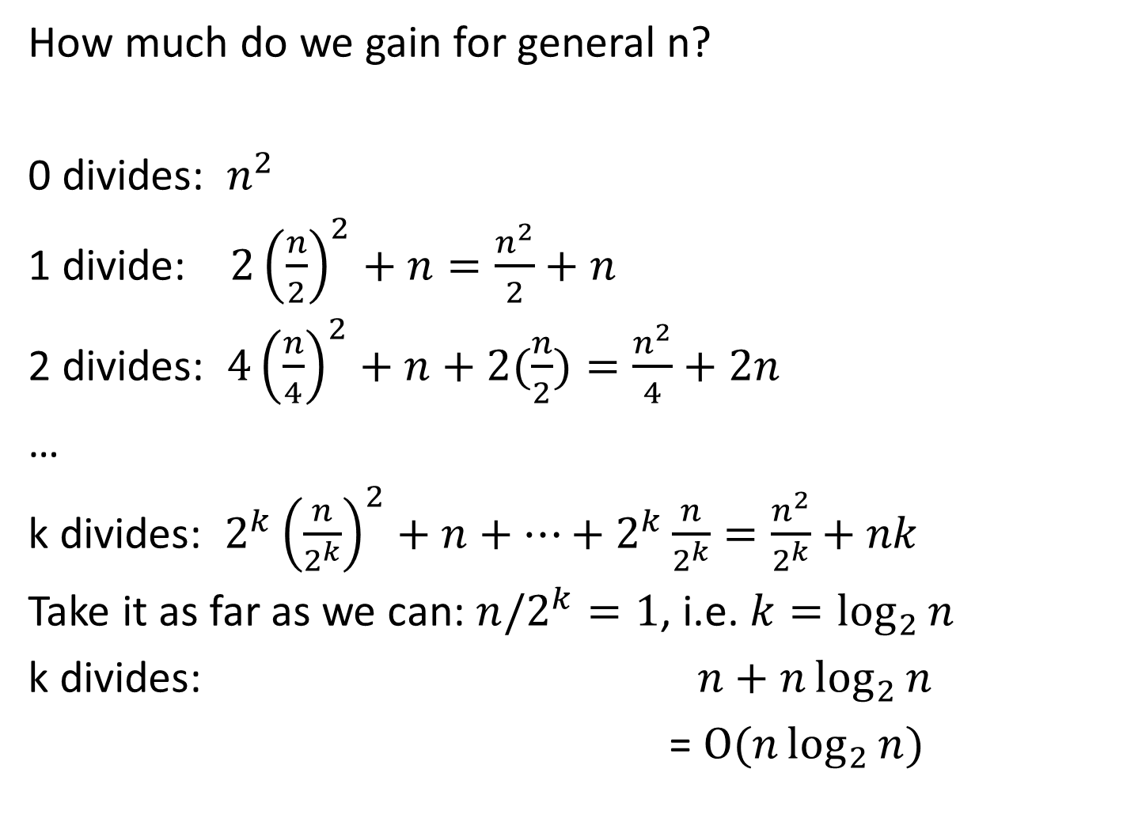
How much do we gain for general n?
0 divides: $n^{2}$
1 divide: $2{\left(\frac{n}{2}\right)}^{2}+n=\frac{n^{2}}{2}+n$
2 divides: $4{\left(\frac{n}{4}\right)}^{2}+n+2(\frac{n}{2})=\frac{n^{2}}{4}+2n$
…
k divides: $2^{k}{\left(\frac{n}{2^{k}}\right)}^{2}+n+⋯+2^{k}\frac{n}{2^{k}}=\frac{n^{2}}{2^{k}}+nk$
Take it as far as we can: ${n/2}^{k}=1$, i.e. $k=\log_{2}{n}$
k divides: $n+n\log_{2}{n}$
= $O(n\log_{2}{n})$
Notes:
Do the maths on visualiser before showing on slide
Illustrate with recursion tree drawn previously

Slide 6
Merge sort

Slide 7

Naive sort: $Θ(n^{2})$
Merge sort
Divide into two equal subarrays
Conquer (sort) those subarrays
Combine (merge) sorted subarrays into sorted array
Combining is $Θ(n)$ using joint iteration
Notes:
65318724
For merge sort, when combining we have two pointers into the subarrays that increment each time
Analysis, exactly the case in the previous slide
Note that pseudocode is in the printed notes

Slide 8
Naive sort: $Θ(n^{2})$
Merge sort
Divide into two equal subarrays
Conquer (sort) those subarrays
Combine (merge) sorted subarrays into sorted array
Combining is $Θ(n)$ using joint iteration
Notes:
65318724
For merge sort, when combining we have two pointers into the subarrays that increment each time
Analysis, exactly the case in the previous slide
Note that pseudocode is in the printed notes

Slide 9
Merge sort code

Slide 10
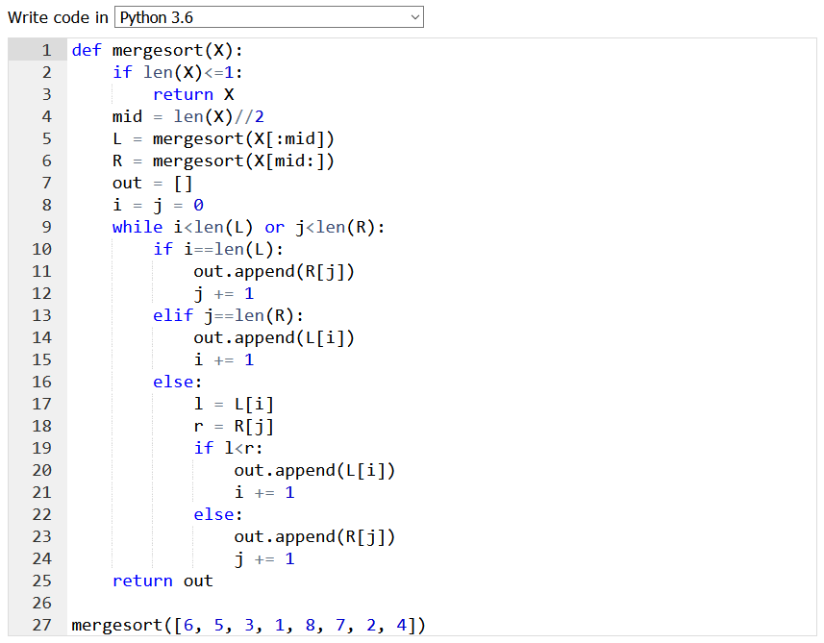
Try it out in
http://pythontutor.com

Slide 11
The master method

Slide 12
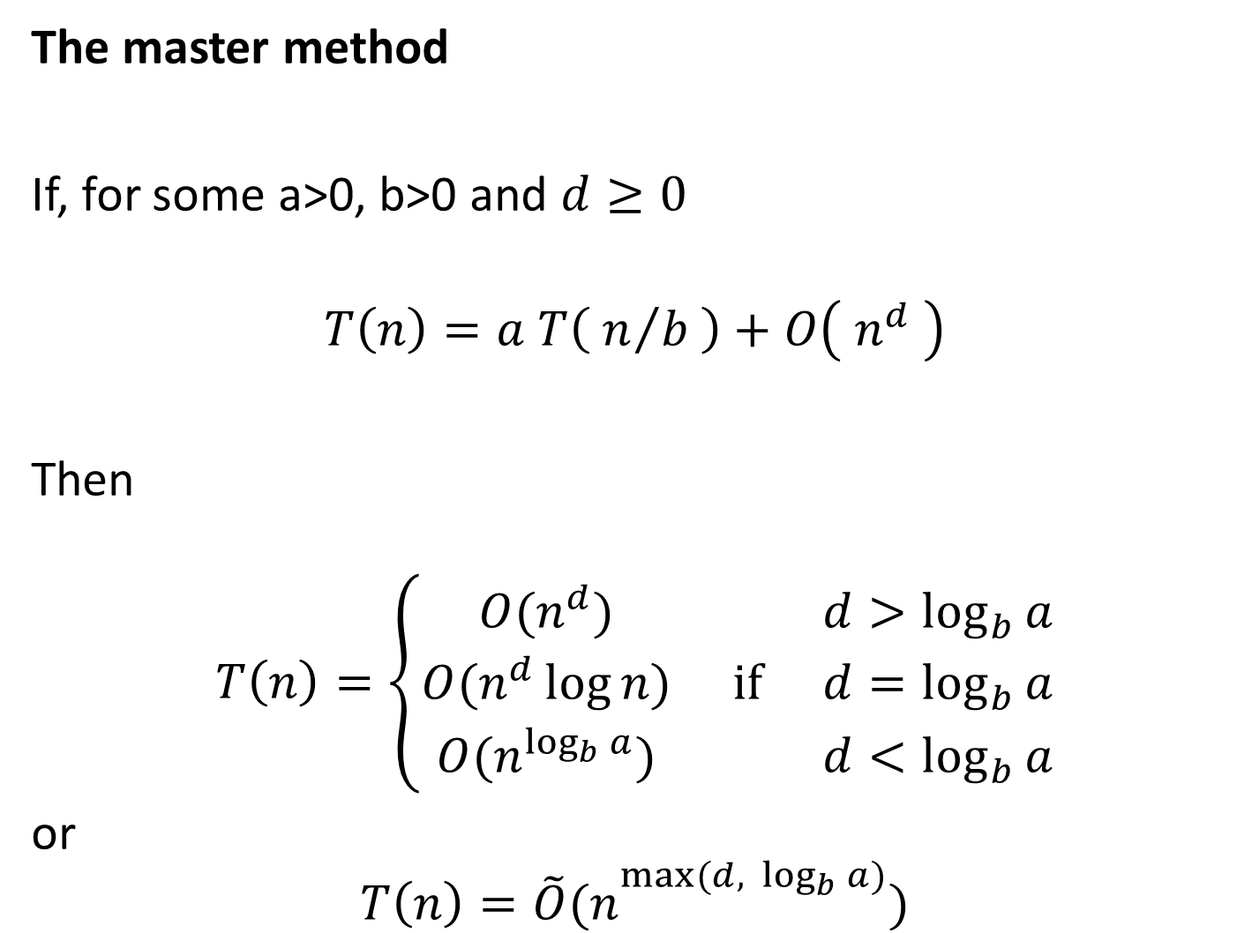
The master method
If, for some a>0, b>0 and $d≥0$
$$T\left(n\right)=a T\left( n/{b }\right)+O\left( n^{d} \right)$$
Then
$$T\left(n\right)=\left\{\begin{matrix}O(n^{d}) & & d>\log_{b}{a} \\ O(n^{d}\log{n}) & \text{if} & d=\log_{b}{a} \\ O(n^{\log_{b}{a}}) & & d<\log_{b}{a}\end{matrix}\right.$$
or
$$T\left(n\right)=\tilde{O}(n^{\max_{}{(d, \log_{b}{a})}})$$
Notes:
Formula for running time
Mathematically hard
Always comes up in exam, but the formula is always stated
Points to note:
A is number of subcases
n/b is the size of each subcase
N^d is how long it takes to combine
Example, merge sort a=b=2, d=1 so logba=1=d so T(n)=O(n log n)

Slide 13
Where does the master method come from?
Optional material

Slide 14
Where does the master method come from?
Total work =
Work done at last step +
Work done combining
Work done at last step = O(work done combining)
Total work = O(work done combining)
Master method
If, for some a>0, b>0 and $d≥0$
$$T\left(n\right)=a T\left( n/{b }\right)+O\left( n^{d} \right)$$
Then
$$T\left(n\right)=\left\{\begin{matrix}O(n^{d}) & & d>\log_{b}{a} \\ O(n^{d}\log{n}) & \text{if} & d=\log_{b}{a} \\ O(n^{\log_{b}{a}}) & & d<\log_{b}{a}\end{matrix}\right.$$
Notes:
Optional if time
Draw recursion tree
Work done at last step = O(work done combining) because you have to do half as many combine ops as final ops for combining at last stage, and each is O(1)

Slide 15
Combining is
$$n^{d}+a{\left(\frac{n}{b}\right)}^{d}+a^{2}{\left(\frac{n}{b^{2}}\right)}^{d}+…+a^{k−1}{\left(\frac{n}{b^{k−1}}\right)}^{d}$$
Simplify this by writing $α=a/b^{d}$
$$n^{d}\left(1+α+α^{2}+…+α^{k−1}\right)=n^{d}\frac{α^{k}−1}{α−1}$$
Three cases:
$α<1$ or $α>1$ or $α=1$
Master method
If, for some a>0, b>0 and $d≥0$
$$T\left(n\right)=a T\left( n/{b }\right)+O\left( n^{d} \right)$$
Then
$$T\left(n\right)=\left\{\begin{matrix}O(n^{d}) & & d>\log_{b}{a} \\ O(n^{d}\log{n}) & \text{if} & d=\log_{b}{a} \\ O(n^{\log_{b}{a}}) & & d<\log_{b}{a}\end{matrix}\right.$$
Notes:
Optional if time
Draw recursion tree
Don’t do alpha=1 case in lecture, a bit more complicated

Slide 16
Work done is ${T\left(n\right)=n}^{d}\frac{α^{k}−1}{α−1}$ $α=a/b^{d}$ $b^{k}=n$
Case 1: $d>\log_{b}{a}$
$b^{d}>a$ (b to the power of both sides)
$α<1$
$T\left(n\right)=n^{d}\frac{α^{k}−1}{α−1}≤\frac{n^{d}}{1−α}≤\text{const}∙n^{d}$
$T\left(n\right)=O(n^{d})$
Master method
If, for some a>0, b>0 and $d≥0$
$$T\left(n\right)=a T\left( n/{b }\right)+O\left( n^{d} \right)$$
Then
$$T\left(n\right)=\left\{\begin{matrix}O(n^{d}) & & d>\log_{b}{a} \\ O(n^{d}\log{n}) & \text{if} & d=\log_{b}{a} \\ O(n^{\log_{b}{a}}) & & d<\log_{b}{a}\end{matrix}\right.$$

Slide 17

Work done is ${T\left(n\right)=n}^{d}\frac{α^{k}−1}{α−1}$ $α=a/b^{d}$ $b^{k}=n$
Case 2: $d<\log_{b}{a}$ so $α>1$
$T\left(n\right)=n^{d}\frac{α^{k}−1}{α−1}≤{const.n}^{d}α^{k}=e^{d\log{n}+k\log{α}}$
$k=\log_{b}{n}=\log{n}/\log{b}$
$\log{α}=\log{a}−d\log{b}$
$d\log{n}+k\log{α}=d\log{n}+(\log{n}/\log{b})(\log{a}−d\log{b})$
$T\left(n\right)$=$e^{\log{n}\log{a}/\log{b}}=e^{\log{n}\log_{b}{a}}=n^{\log_{b}{a}}$
Master method
If, for some a>0, b>0 and $d≥0$
$$T\left(n\right)=a T\left( n/{b }\right)+O\left( n^{d} \right)$$
Then
$$T\left(n\right)=\left\{\begin{matrix}O(n^{d}) & & d>\log_{b}{a} \\ O(n^{d}\log{n}) & \text{if} & d=\log_{b}{a} \\ O(n^{\log_{b}{a}}) & & d<\log_{b}{a}\end{matrix}\right.$$

